Slide 1
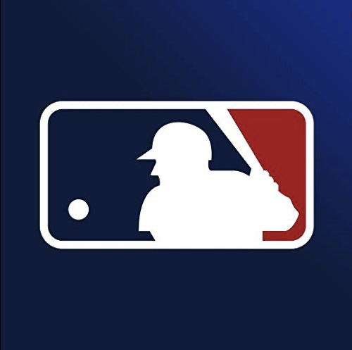
MLB All Stars
Stephen Nelson, Joshua Higgins, Cameron Greenwalt

Slide 2
MLB 2002 Season
Oakland A’s had $42 million to spend on players
New York Yankees had $125 million to spend
A’s lost their best players to teams who could afford to pay them more

Slide 3
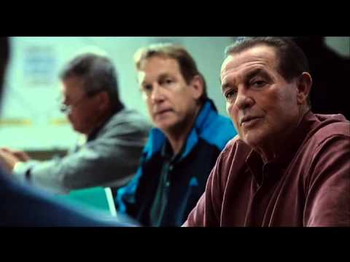
Player Selection

Slide 4

Moneyball

Slide 5
Data
All Stars
A list of all players who at any time in their career made the All-Star team
Batting Stats
Batting stats for all seasons for all players in MLB history
Player Data
Information about the player such as height, weight, hometown
Final Dataset consisted of 15,328 players’ rookie season statistics.

Slide 6
Baseline
Original Test Set - 3,066
Baseline Accuracy (Predicting all players as NOT all-stars): 89.11%

Slide 7
Not Enough Data
We decided to add some fake players by adding a little random noise to current all star player data to allow the model to learn more “all-stars”.

Slide 8
Removing Players
We also noticed many players in their rookie year did not have significant statistics if they had played in fewer than 30 at-bats.

Slide 9
Results
Max | Remove <30 at-bat players
 | No upsample |  |  | Yes upsample
 | RF | XG | MLP | RF | XG | MLP
Precision | 0.43 | 0.48 | 0.56 | 0.50 | 0.55 | 0.42
Recall | 0.07 | 0.06 | 0.02 | 0.09 | 0.09 | 0.24
Accuracy | 0.89 | 0.89 | 0.89 | 0.85 | 0.85 | 0.84
F1 Score | 0.11 | 0.11 | 0.03 | 0.16 | 0.16 | 0.30
Max | Not remove <30 at-bat players
 | No upsample |  |  | Yes upsample
 | RF | XG | MLP | RF | XG | MLP
Precision | 0.40 | 0.48 | 0.32 | 0.35 | 0.51 | 0.36
Recall | 0.06 | 0.06 | 0.08 | 0.07 | 0.11 | 0.21
Accuracy | 0.89 | 0.89 | 0.88 | 0.88 | 0.89 | 0.87
F1 Score | 0.10 | 0.11 | 0.13 | 0.12 | 0.18 | 0.27

Slide 10
Recall & Precision & F1 Score

Slide 11
Challenges
Not enough data
Human performance can never be predicted exactly

